Slide 1
Assignment 5
Review of Group 9’s UML Diagram
Group 6 Members:
Chengchao Fang
Chentao Han
Kai Wang
Yiran Jin

Slide 2
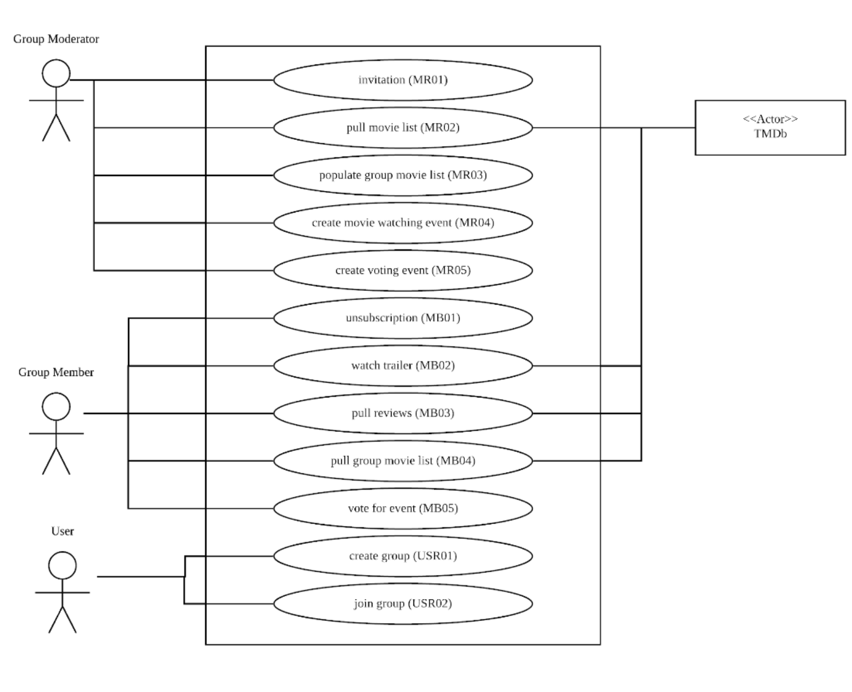
Use Case Diagram from Group 9

Slide 3
Review of Use Case Diagram
Inspection Item | Pass/Fail/Partial | Comments
1.Represent a system in a rectangle and put the name of system at the top | Partial | According to the use case diagram from group 9, they use a rectangle to present a system. But they do not put the name of system at the top, so viewers are confused about what this application is.
2.Actors are external objects, they need to be placed outside the system | Pass | This part is well done! All actors in this use case diagram are placed outside the rectangle.

Slide 4
Review of Use Case Diagram
Inspection Item | Pass/Fail/Partial | Comments
3. Actors should be categorical, not specific | Partial | Their actors are partially categorical. I think the Group Member and User are exactly same actor.
4. Primary actors which initiate the use of the system should be placed at the left of system, secondary actors which are reactionary should be placed at the right of system | Fail | Group Moderator should be the actor who initiate the whole process, so it should be placed at the left of system. User should be the actor who makes some reactions after moderator, so it should be placed at the right of system.

Slide 5
Review of Use Case Diagram
Inspection Item | Pass/Fail/Partial | Comments
5. The meaningfulness and ambiguity of use case name | Pass | Well done! Each use case has a unique name. The name is a verb + noun phrase and the name accurately summarize the main purpose of the use case.
6. The correctness and completeness of relationships between use cases and actors | Partial | Viewers are confused about the relationships between use cases and “TMDb”.

Slide 6
Review of Use case specification
Inspection Item | Pass/Fail/Partial | Comments
1.Each precondition represent a tangible state of the system. | Partial | According to the guideline, a precondition of a use case explains the state that the system must be in for the use case to be able to start. So, “on xx page” might not a precondition.
2.It is clear how the use case starts. | Partial | It will be more intuitive to write it this way ‘The use case starts when <Actor name> <does something>.’.

Slide 7
Review of Use case specification
Inspection Item | Pass/Fail/Partial | Comments
3.The flow have a definite ending | Partial | Maybe "The use case ends" or "The use case ends with a failure" would be a better way to define The ending.
4.For each alternate flow, the conditions for initiation of the flow are clearly defined. | Partial | Each scenario describes alternate ways that the system behaves, or it may describe failure or exception cases. In some of the use case specification, it only shows successful result

Slide 8
Review of Use case specification
Inspection Item | Pass/Fail/Partial | Comments
5.the post-conditions specified | Partial | A post-condition of a use case lists possible states that the system can be in after the use case runs. However, in the use case specification, the post-conditions don’t show the failure condition.

Slide 9
Review of Sequence Diagram
Inspection Item | Pass/Fail/Partial | Comments
1.The Sequence Diagram are clear and understandable based on the class diagram | Pass | In group 9’s sequence diagram, every sequence diagram are strictly based on their class diagram. And the functions are all showed in the sequence diagram.
2. For each Sequence Diagram, there are three parts: Model, View, Controller. | Pass | In each group 9’s sequence diagram, there are at least three parts. For example, model(moderator), TrailView(View), and MemberController(Control).

Slide 10
Review of Sequence Diagram
Inspection Item | Pass/Fail/Partial | Comments
3.The Sequence Diagram’ s request and return are logical and continuous. | Pass | According to group 9’s work, their sequence diagram are really logical with the request and return.
4. The lines of the sequence diagram are used appropriately. | Pass | The request lines the group use are solid line and the return lines are break lines. So it is right.

Slide 11
Review of Sequence Diagram
Inspection Item | Pass/Fail/Partial | Comments
5. The sequence diagram shows some specific condition during the process | Partial | Group 9’s graph shows some conditions such as there are loops during that process, which satisfy the request.

Slide 12
Review of Class Diagram
Inspection Item | Pass/Fail/Partial | Comments
1. All model elements and relationships as outlined in the Vision Document (Section 3.2) are present in the architecture document as classes. | Pass | You guys did a really well job.

Slide 13
Review of Class Diagram
Inspection Item | Pass/Fail/Partial | Comments
2.Each class is interconnected appropriate and contains an indication of a quantitative relationship | Pass | I think we need to add a line between movie list and the watching event. Because every event may have has its own list or the list can be shared.
3.Each class is interconnected appropriate and contains an indication of a quantitative relationship | Pass | And I think one moderator may can create many movie lists. So the relation is 1 to n.

Slide 14
Review of Class Diagram
Inspection Item | Pass/Fail/Partial | Comments
4.The description of the class diagram is accurate, and the functions and relationships are described accurately | Pass | I think we can be a little bit more specific. Such as Movie List’s description can be changed to the movie list populated by moderator in each group through API.
5. Contains all the classes needed in the project, and specifies the class's properties and methods | Pass | You guys did a really well job. I have no comment because It is prefect.

